Slide 1

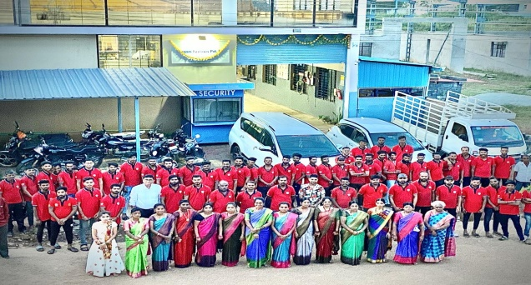
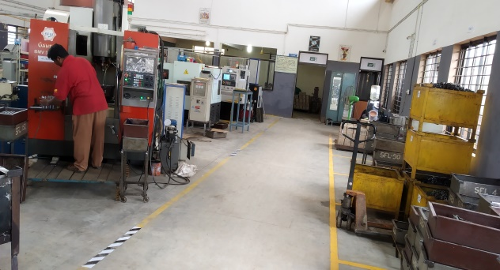
Vendor Information
SANGAM FASTNERS PVT LTD
Vendor Info :
Company Image:
Vendor Name | SANGAM FASTNERS PVT LTD
MD Name | Mr Sangmesh I Handigol
Category | Medium
Employee | 120 No’s
Distance | From SIEL:15KM | From Airport:8kM | MD Photo
Out | Shop floor
Infra Details :
Sales Details (INR/Lacs)
Details | Information | Remarks
Type (Own/Rent) | Own
Build up Area (m²) | 20000 m²
Total landed Area (m²) | 25000 m²
Additional WH (Y/N) | YES | 10000 m²
Elec Power (KVA) | 125+65+40+30 | KVA
Machine details | List of Machine | File Attached
 | List of Instruments | File Attached
Sales | 2022-23 | 2023-24
TTL | 4000 | 4800
SAM | 583 | 693
Major Items
Product | Major Parts Supplies
Fasteners | File attached
Shaft’s | File attached

Slide 2










Our Esteemed Clients For Fasteners

Slide 3








Our Esteemed Clients For Shaft’s and Automotive Part’s

Slide 4
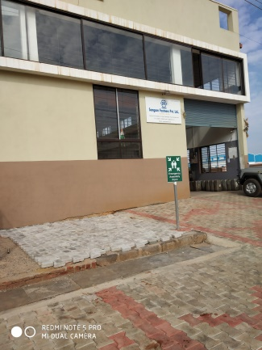
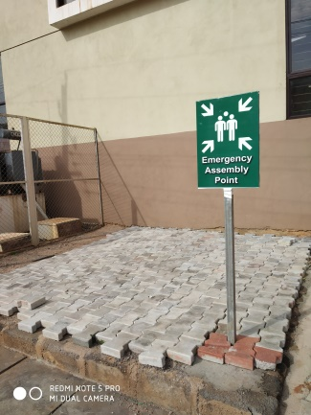
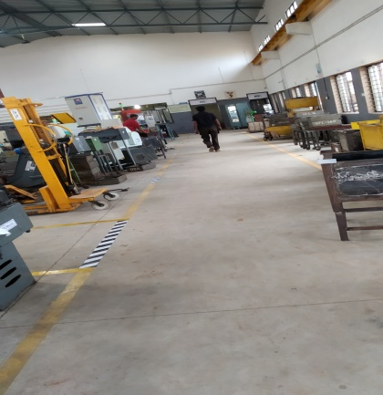
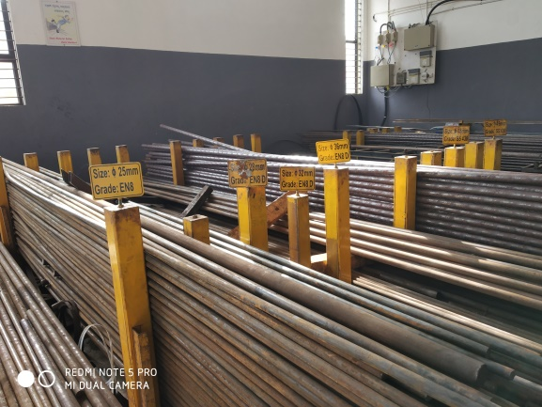
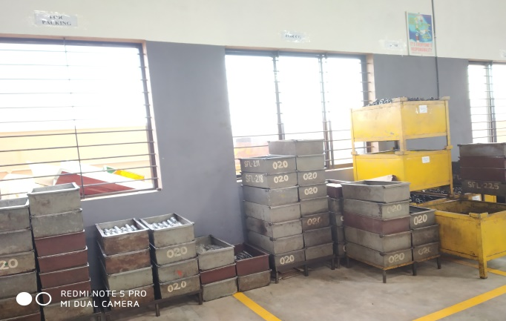
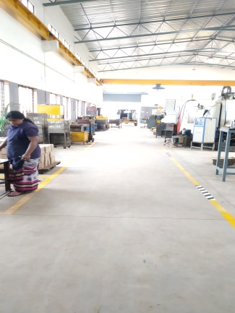

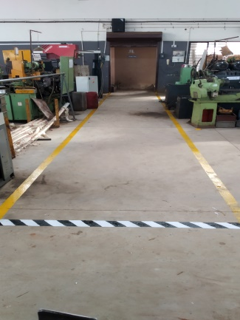
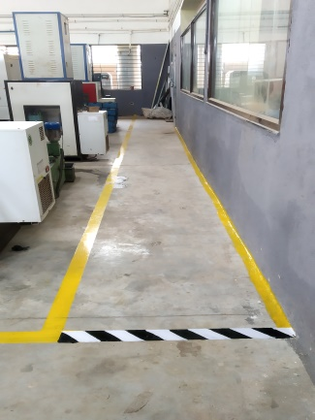
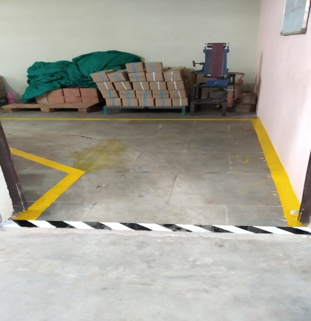
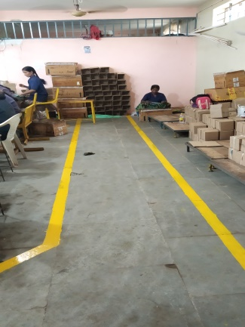
SANGAM FASTENERS PLANT PHOTOS SHOP FLOOR

Slide 5
List of Machinery & Equipment's
Sl no | Name Of Machine and utilities | Year of Installation | Make
1 | CIRCULAR SAW CUTTING MACHINE | 2018 | ZEAL TECH AUTOMATION
2 | CIRCULAR SAW CUTTING MACHINE | 2021 | ZEAL TECH AUTOMATION
3 | U - DRILLING MACHINE | 2019 | PRECICUT TOOL
4 | U - DRILLING MACHINE | 2010 | STEEL TECH AUTOMATION
5 | CNC TURNING CENTER MIDAS 6 OLD | 2011 | GALAXY MIDAS 6
6 | CNC TURNING CENTER MIDAS NEW | 2014 | GALAXY MIDAS 6
7 | CNC TURNING CENTER MEDA | 2008 | GALAXY MIDAS 6
8 | CNC TURNING CENTER MIDAS 6 | 2017 | GALAXY MIDAS 6
9 | DRILLING & TAPPING MACHINE | 2011 | PRECICUT TOOL
10 | VERTICAL MILLING CENTER GOURAV | 2011 | GAURAV BMV 35 TC220
11 | VERTICAL MILLING CENTER CHANDRA | 2011 | CHANDRA
12 | HYDRAULIC THREAD ROLLING MACHINE | 2017 | THREAd AID
13 | HYDRAULIC THREAD ROLLING MACHINE OLD | 2000 | VENKATESHWAR INDUSTRIES
14 | HYDRAULIC PRESSING MACHINE | 2005 | POLHYDRON PVT LTD

Slide 6
List of Machinery & Equipment's
Sl no | Name Of Machine and utilities | Year of Installation | Make
15 | HYDRAULIC PRESSING MACHINE | 2005 | LINER ASSEMBLY
16 | CNC TURNING CENTER MEDA 4I | 2009 | FINISH TURNING
17 | CNC CYLINDRICAL GRINDING MACHINE | 2012 | OUTER DIA SURFACE FINISH
18 | CNC TURNING CENTER MIDAS 6 PLUS | 2015 | FINISH TURNING
19 | CNC CYLINDRICAL GRINDING MACHINE | 2015 | OUTER DIA SURFACE FINISH
20 | CNC TURNING CENTER MIDAS 6 PLUS | 2016 | FINISH TURNING
21 | CNC CYLINDRICAL GRINDING MACHINE | 2017 | OUTER DIA SURFACE FINISH
22 | TROBE MACHINE | 2014 | PARTING
23 | HYDRAULIC PRESSING MACHINE | 2005 | LINER ASSEMBLY
24 | PUNCHING MACHINE | 2000 | PUNCHING
25 | BUFFING MACHINE | 2005 | BUFFING
26 | DRILLING & TAPPING MACHINE | 2019 | DRILLING & TAPPING
27 | EN SERIES ROTARY SCREW AIR COMPRESSOR | 2018 | AIR SUCK & STORE
28 | AIR COMPRESSOR | 2008 | AIR SUCK & STORE

Slide 7
List of Machinery & Equipment's
Sl no | Name Of Machine and utilities | Year of Installation | Make
29 | 13*13 MANUAL SUPER LATHE M/C | 2000
30 | TABLE GRINDING MACHINE | 2000
31 | TABLE DRILLING MACHINE | 2000
32 | TAP CHECK MACHINE | 2021 | X FLOW TECHNOLOGIES
33 | TAP CHECK MACHINE | 2021 | X FLOW TECHNOLOGIES
34 | ACE CNC LATHE MODEL: J 300 LM | 2021 | ACE DESIGNERS LTD.
35 | ACE CNC LATHE MODEL: J 300 LM | 2021 | ACE DESIGNERS LTD.
36 | ELGi Air Compressor Manual | 2014 | eLGI
37 | BOLT TIGHTNING MACHINE | 2021 | X FLOW TECHNOLOGIES
38 | BOLT TIGHTNING MACHINE | 2021 | X FLOW TECHNOLOGIES
39 | BOLT TIGHTNING MACHINE | 2021 | X FLOW TECHNOLOGIES
40 | HYDRAULIC THREAD ROLLING MACHINE | 2022 | THREAD AID
41 | MANUAL DRILLING TAPPING MACHINE | 2022 | RAJESH TRADERS RAJKOT
42 | AUTOMATIC PICK AND PLACE | 2022 | ARROWS ENGINEERING

Slide 8
List of Machinery & Equipment's
Sl no | Name Of Machine and utilities | Year of Installation | Make
43 | ROBOTIC ARM | 2022 | ARROWS ENGINEERING
44 | ACE CNC LATHE MODEL: J 300 LM | 2022 | ACE DESIGNERS LTD.
45 | ACE CNC LATHE MODEL: J 300 LM | 2022 | ACE DESIGNERS LTD.
46 | CNC CYLINDRICAL GRINDING MACHINE | 2022 | HI-LIFE
47 | BOLT TIGHTNING MACHINE | 2021 | X FLOW TECHNOLOGIES
48 | DRILLING & TAPPING MACHINE | 2022 | PRECICUT TOOL
49 | U-DRILLING MACHINE | 2022 | PRECICUT TOOL
50 | EN SERIES ROTARY SCREW AIR COMPRESSOR | 2023 | ELGI
51 | POLYTRON MILLING MACHINE | 2024 | TRISHUL

Slide 9
List of Measuring Instruments
Sl no | MEASURING INSTRUMENT | Range/Size | Least Count | Make
1 | VMM MACHINE ( non-contact measuring machine) | 400*200*100 | 0.0001 | ESSON
2 | SURAFACE ROUGHNESS TESTER | 0.03 mm | 0.0001 | MITUTOYO
3 | DIGITAL VERNIER HEIGHT GUAGE | 0 - 300 mm | 0.02 | BAKER
4 | DIGITAL VERNIER HEIGHT GUAGE | 0 - 300 mm | 0.02 | YUZUKI
5 | DIGITAL VERNIER HEIGHT GUAGE | 0 - 300 mm | 0.02 | YUZUKI
6 | VERNIER CALIPER DIGITAL | 0-150 | 0.002 | YUZUKI
7 | VERNIER CALIPER DIGITAL | 0 - 150 | 0.002 | INSIZE
8 | OUTSIDE MICROMETER (DIGITAL) | 0-25 | 0.001 | MITUTOYO
9 | OUTSIDE MICROMETER (DIGITAL) | 0-25 | 0.001 | MITUTOYO
10 | OUTSIDE MICROMETER (DIGITAL) | 0-25 | 0.001 | MITUTOYO
11 | OUTSIDE MICROMETER (DIGITAL) | 25-50 | 0.001 | MITUTOYO
12 | OUTSIDE MICROMETER (DIGITAL) | 25-50 | 0.001 | MITUTOYO
13 | OUTSIDE MICROMETER (DIGITAL) | 0-25 | 0.001 | MITUTOYO
14 | OUTSIDE MICROMETER (DIGITAL) | 25-50 | 0.001 | MITUTOYO

Slide 10
List of Measuring Instruments
Sl no | MEASURING INSTRUMENT | Range/Size | Least Count | Make
15 | OUTSIDE MICROMETER (DIGITAL) | 25-50 | 0.001 | MITUTOYO
16 | OUTSIDE MICROMETER | 0-25 | 0.01 | MITUTOYO
17 | OUTSIDE MICROMETER | 25-50 | 0.01 | MITUTOYO
18 | OUTSIDE MICROMETER | 25-50 | 0.01 | MITUTOYO
19 | OUTSIDE MICROMETER | 0-25 | 0.01 | MITUTOYO
20 | OUTSIDE MICROMETER | 0-25 | 0.01 | MITUTOYO
21 | OUTSIDE MICROMETER | 25-50 | 0.01 | MITUTOYO
22 | SNAP GAUGE | 13(-0.02) |  | SAMARTH GAUGE TOOLS
23 | SNAP GAUGE | 13 (-0.1,-0.15) |  | SAMARTH GAUGE TOOLS
24 | SNAP GAUGE | 18 (-0.05,-0.1) |  | SAMARTH GAUGE TOOLS
25 | SNAP GAUGE | 13(-0.02) |  | SAMARTH GAUGE TOOLS
26 | SNAP GAUGE | 13 (-0.1,-0.15) |  | SAMARTH GAUGE TOOLS
27 | HARDNESS TESTING MACHINE
28 | M8 THREAD PLUG GAUGE |  |  | BAKER

Slide 11
List of Measuring Instruments
Sl no | MEASURING INSTRUMENT | Range/Size | Least Count | Make
29 | M10 THREAD PLUG GAUGE |  | BAKER | SFL/TP-02
30 | M12 THREAD PLUG GAUGE |  | BAKER | SFL/TP-03
31 | SURFACE PLATE 640*400 MM |  | LUTHRA | SFL/SP-01
32 | BENCH CENTER |  | PRECESION | SFL/BC-01

